Slide 1

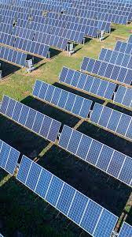


Presentation 2024
INTERNSHIP PROJECT
Prepeared By:
Saiyed Rahil (B.E. IT 2021-2025)
Gujarat Technological University

Slide 2

Content
01
Overview
02
Objectives
03
System Architecture
04
Steps Involved
05
Working Through E.R.Diagram
06
Benefits & Impact
07
ConDrawbacks & future enhancementstact
08
conclusion

Slide 3





Overview
The Full-Stack Data Management and Visualization Platform represents a significant step forward in the efficient handling of big data, offering a powerful tool for organizations to manage and visualize their data effectively.
01
To visualize the static solar plants assets data into an easy readable format and provide one platform for all the operation for user to get data standardized
This need is particularly evident in the renewable energy sector, where vast amounts of data are generated daily from various sources
02
03
The platform integrates with Google BigQuery to handle large datasets efficiently, ensuring real-time updates and synchronization
Users can perform CRUD operations directly within the application, with changes instantly reflected in the BigQuery database
04

Slide 4





Objectives
project's overall objectives and goals.
Objective 01
To visualize the real-time solar assets data into an easy and readable format and provide one platform for all operation for the user to get data standardized
Objective 02
To address all challenges, of data getting located any where in the excel this project will act as a central platform for any solar related data

Slide 5



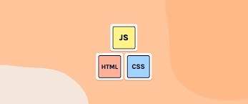

System Architecture
Flask as Backend
HTML, CSS, JS as Frontend
Big Query as Database
Flask is a web framework that allows developers to build lightweight web applications quickly and easily with Flask Libraries.
HTML provides the basic structure of sites, which is enhanced and modified by other technologies like CSS and JavaScript.
BigQuery is a fully managed, AI-ready data platform that helps you manage and analyze your data with built-in features
Various latest and possibly the fastest technologies have been used in order give the wen app the Smooth, Fast and Responsive UI and Functionalities

Slide 6




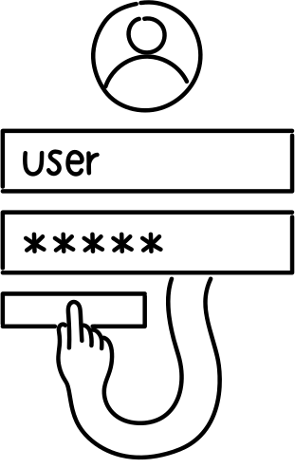
5th Step
Save the changes in order to reflect it in Database
4th Step
change the data according to your specifications (CRUD)
3rd Step
Access the table through Big Query Database
Steps Involved
various Step Involved in order to access the platform and perform operation
2nd step
Select the plants and the corresponding blocks
1st step
Login using the provided credentials

Slide 7

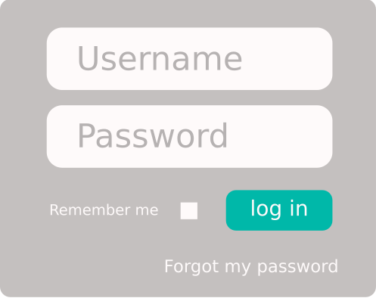
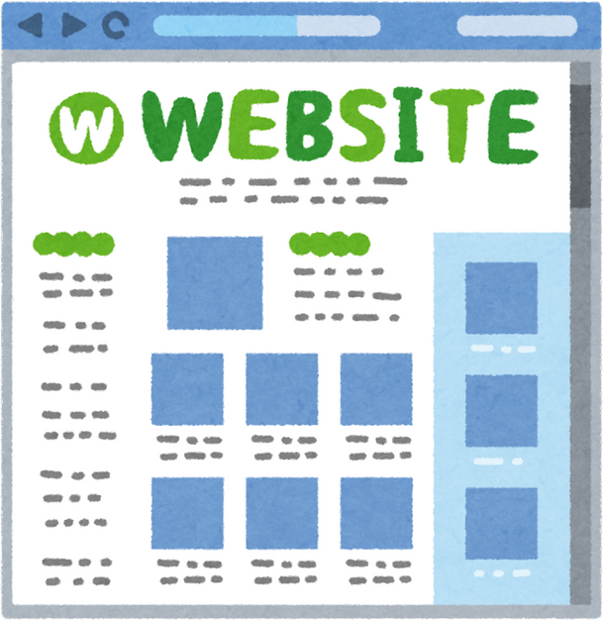





WORKING
An E.R.Diagram to demonstrate how the project works
Login
Access the site
Access the data
Update the data
session will end
database will be updated
Save/ Delete Data

Slide 8


Benefits and Impact
Operational Efficiency:
Improved data management.
Enhanced decision-making.
Scalability:
Capable of handling large datasets.
Real-time updates.
User Experience:
Intuitive interface.
Seamless interaction between backend and frontend.
Sales

Slide 9





Drawbacks & future enhancements
01 Authentication & security
Authorization can be provided but authentication feature is not there till now which can be added further and security functionality can be added
02 Session Management
Till now the session last until the user has closed its browser but time based session management can be provided along with the cookies which cann modify the site according to user prefrence
03 Multiple features like excel
The website lacks advance features like the we get in excel such as making a plant as important, highlighting plants and loading data in bulk.
04 Additional data visualization
Currently the Visualization feature is provided just the summary of the plant is rendered we can also provide the data visualization through various python libraries.

Slide 10
CONCLUSION
Through this we can conclude that....
This project demonstrates the successful integration of backend and frontend technologies to solve real-world problems.
It highlights the importance of data-driven decision-making and the role of efficient data management in achieving it.

Slide 11
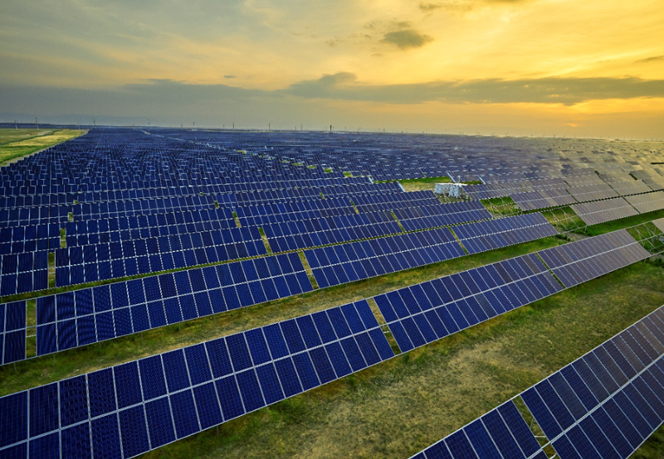





THANK YOU
Saiyed Rahil RiyazAhmed
+91 9265825711
rahilsaiyed008@gmail.com
rahilsaiyed1711.github.io/portfolio/
Ahmedabad, Gujarat, India

